Slide 1
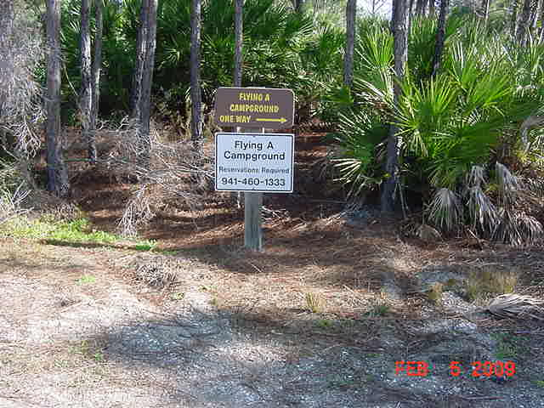
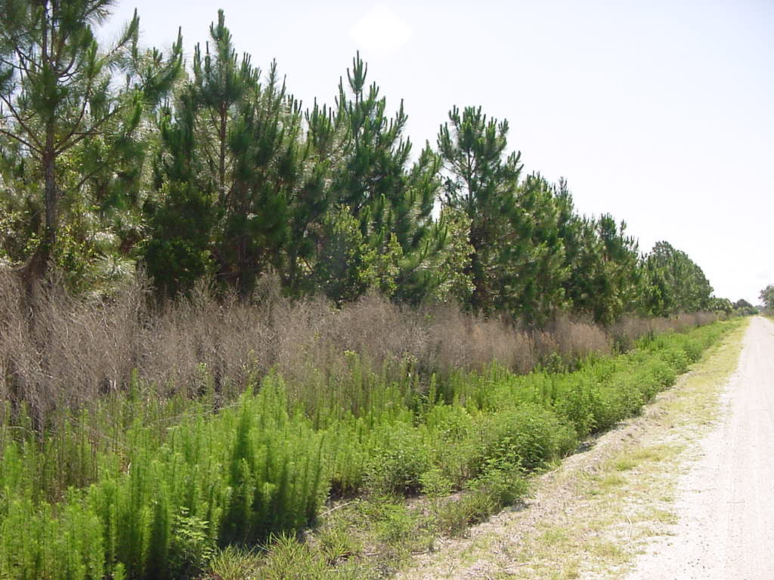
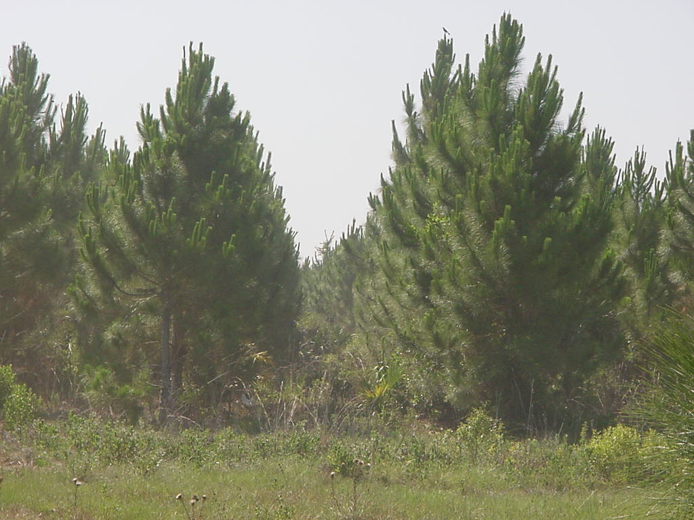
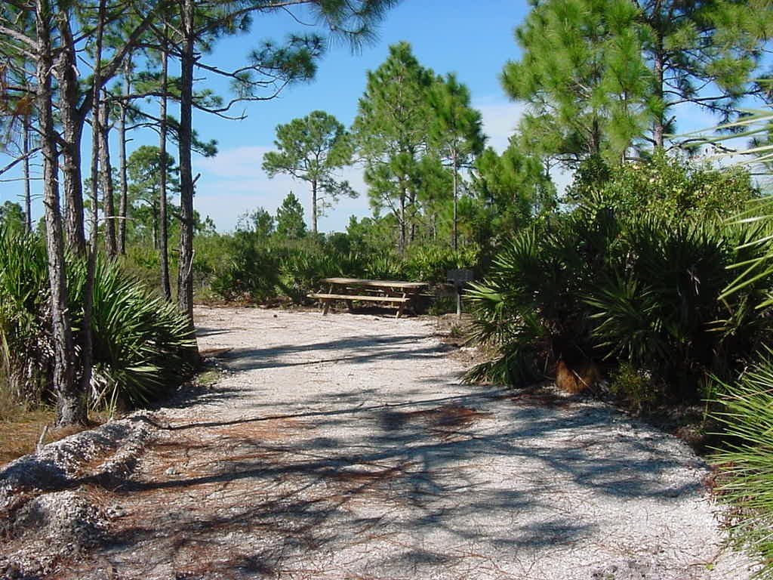
Myakka State Forest June 2012

Slide 2
Activities on the Forest
Pine Planting
Exotic control
New additions to our South Loop Trail
75th Anniversary FL state Forests
Prescribed Burns
10 year Mgmt Plan

Slide 3
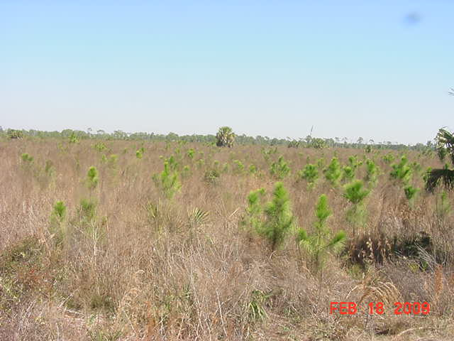
2005-6 planting of S FL slash
Inset shows pines 3 years after planting

Slide 4
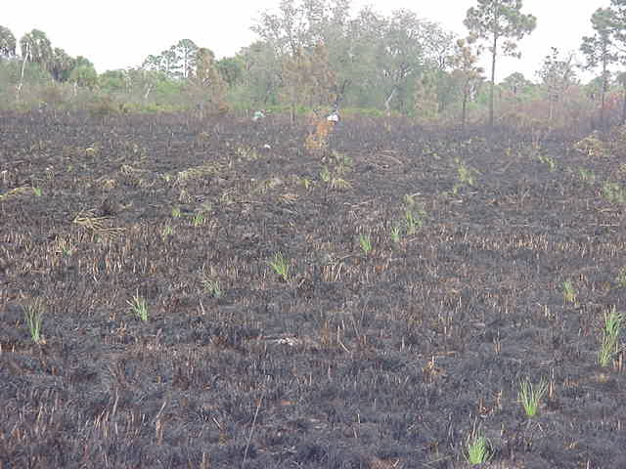
Longleaf Pine planting 2006-7
Pines at planting

Slide 5
Activities on the Forest
Pine Planting
Exotic control
New additions to our South Loop Trail
75th Anniversary FL state Forests
Prescribed Burns
10 year Mgmt Plan

Slide 6
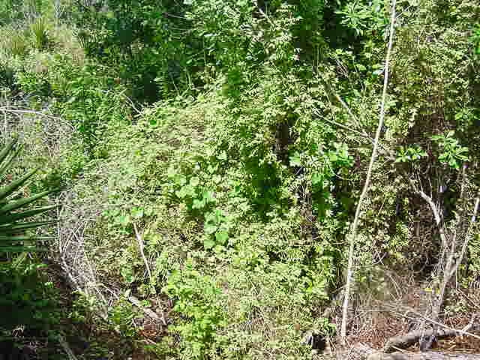
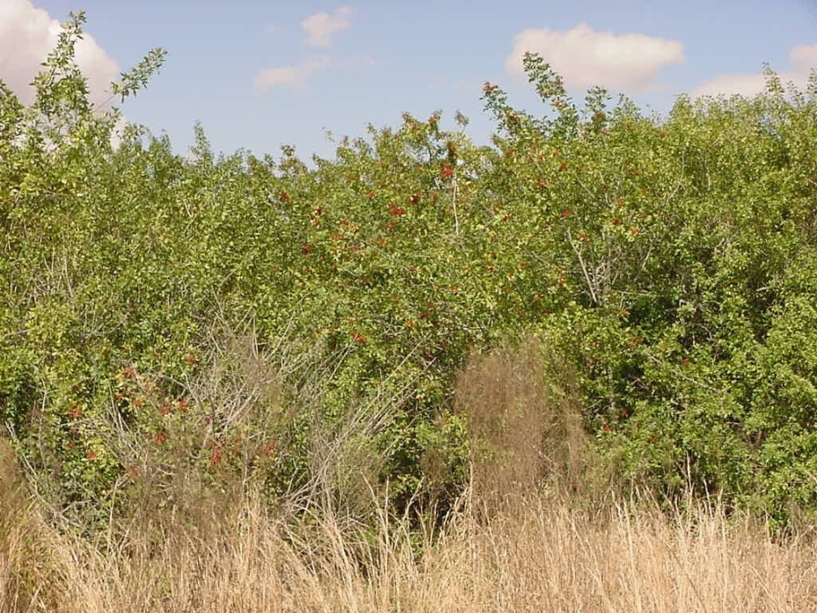
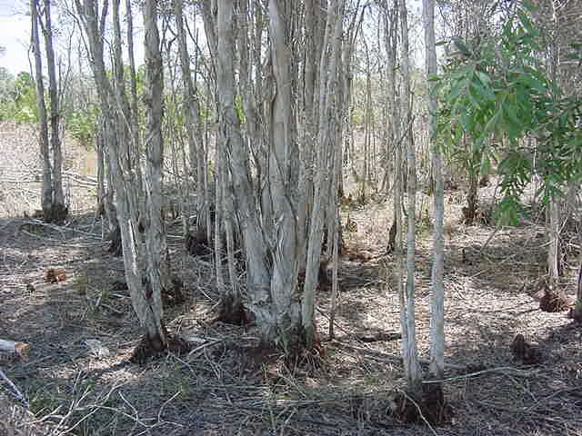
Non-Native Invasive Plant Control
treated fiscal year 2011 – 12
Melaleuca ………42 ac
Bra. Pepper…......28 ac
Cogongrass………7 ac
Old-World ……….5 ac

Slide 7
Activities on the Forest
Pine Planting
Exotic control
New additions to our South Loop Trail
75th Anniversary FL state Forests
Prescribed Burns
10 year Mgmt Plan

Slide 8
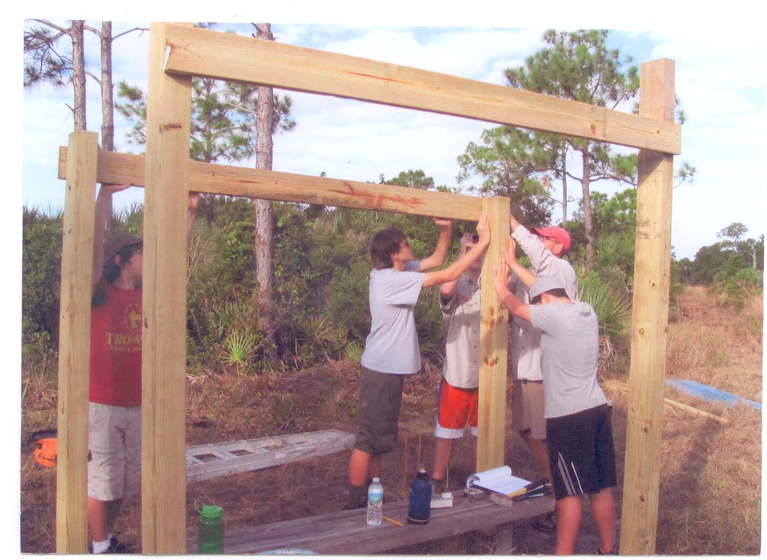
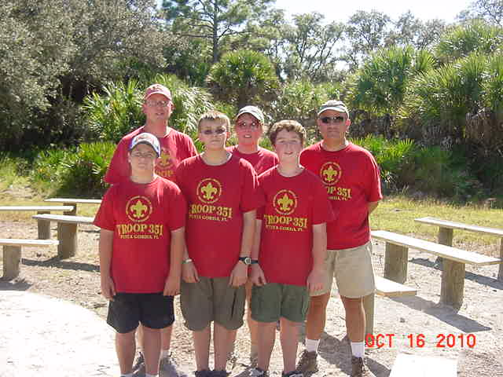
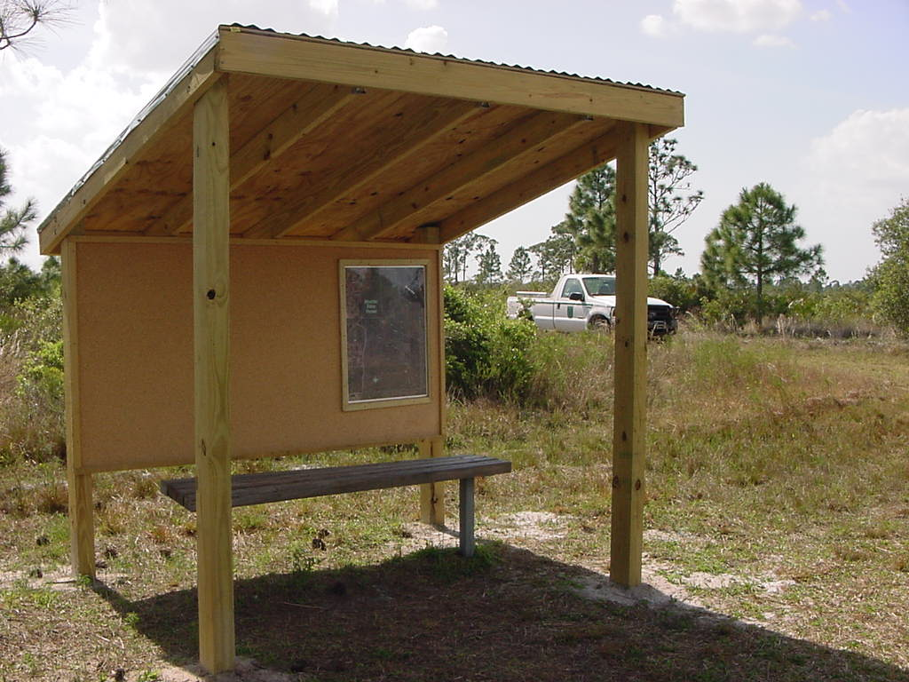
Eagle Scout Projects

Slide 9
Activities on the Forest
Pine Planting
Exotic control
New additions to our South Loop Trail
75th Anniversary FL state Forests
Prescribed Burns
10 year Mgmt Plan

Slide 10
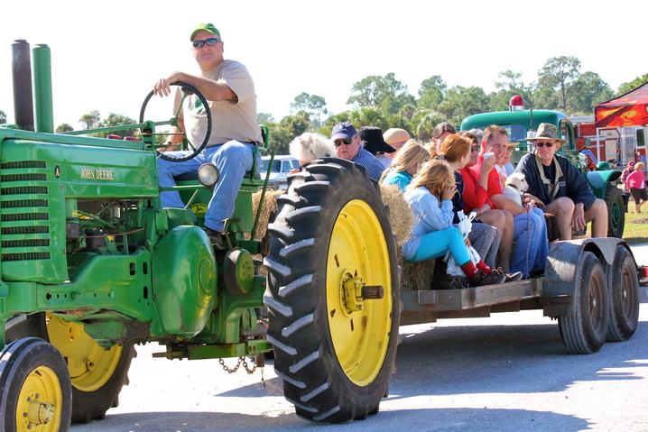
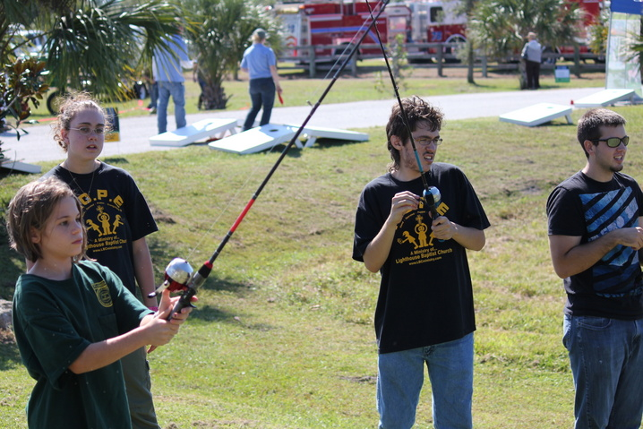
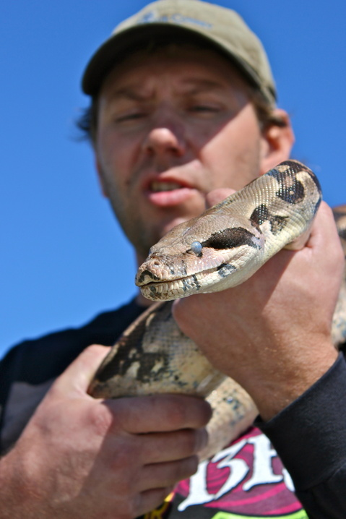
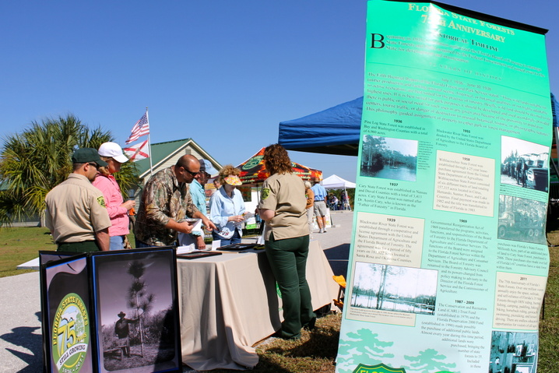
250 enjoyed a variety of things to see and do

Slide 11
Activities on the Forest
Pine Planting
Exotic control
New additions to our South Loop Trail
75th Anniversary FL state Forests
Prescribed Burns
10 year Mgmt Plan

Slide 12
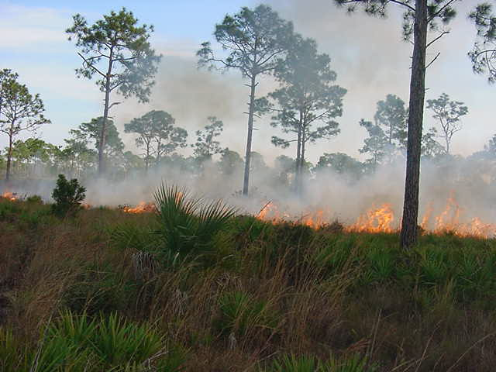
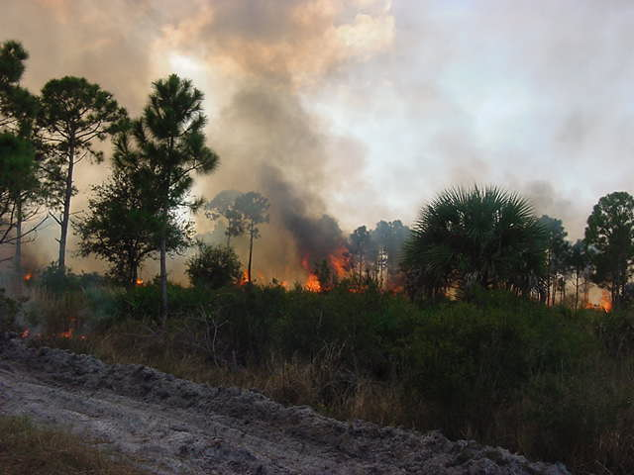
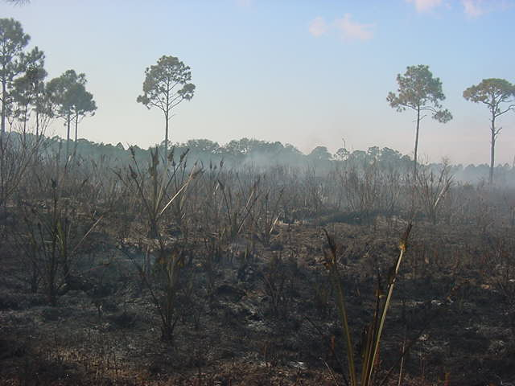

Slide 13
Previously we operated on a 4 year rotation for the forest .
However……
Burn units for 2012 – 13
Total = 2,726 acres
This is 32% of the forest

Slide 14
Activities on the Forest
Pine Planting
Exotic control
New additions to our South Loop Trail
75th Anniversary FL state Forests
Prescribed Burns
10 year Mgmt Plan

Slide 15
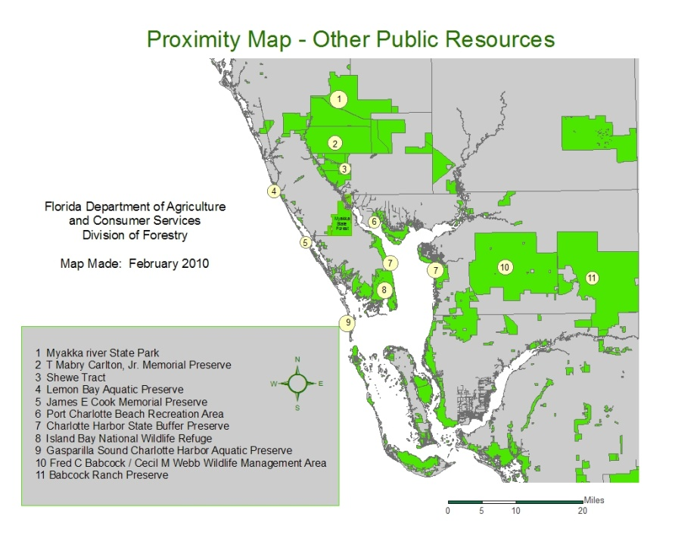
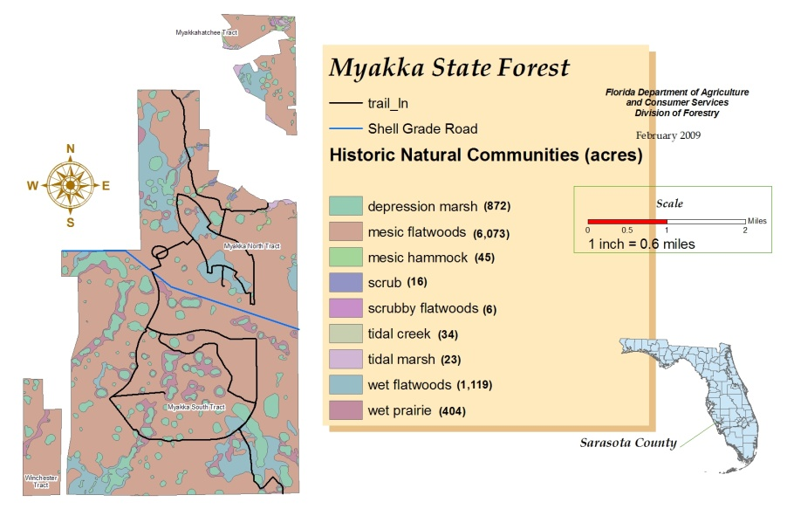
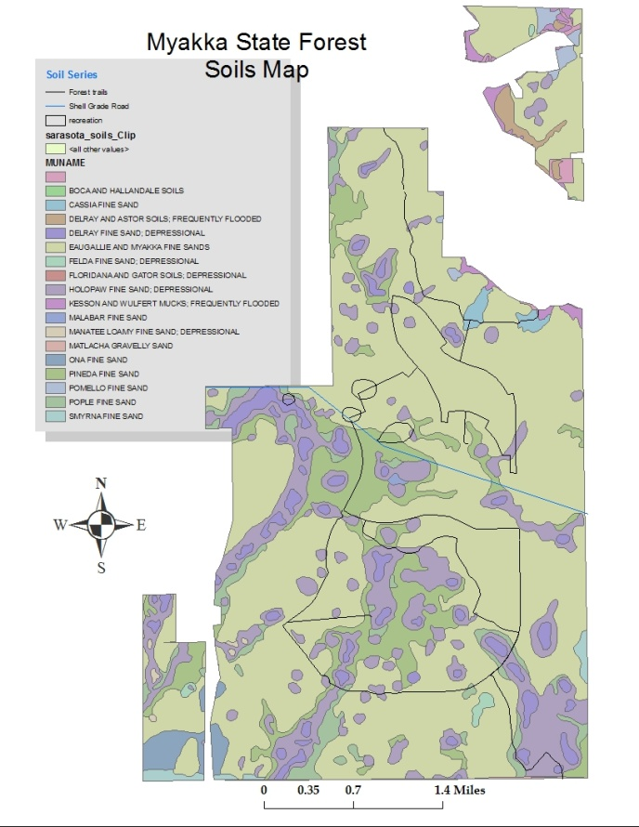
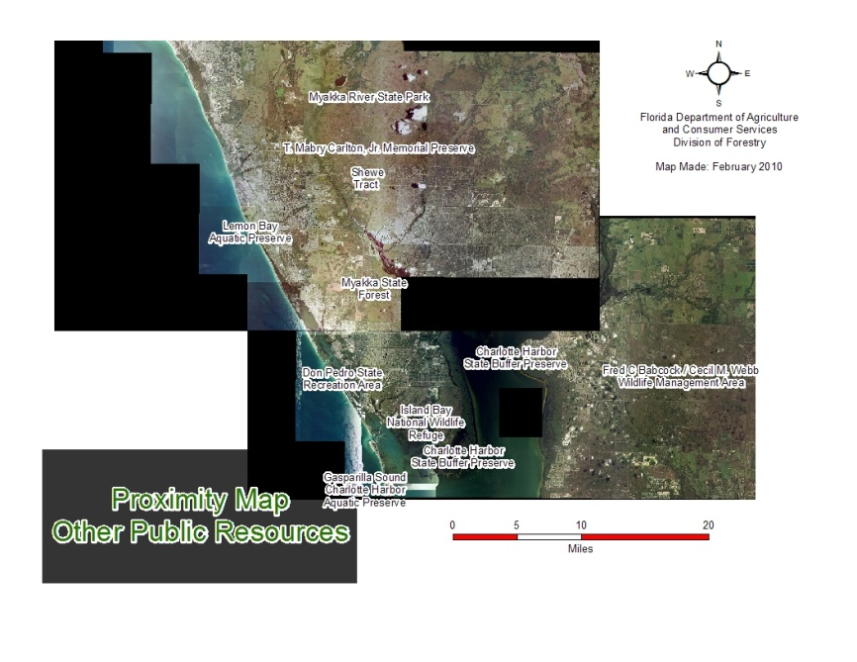
Mgmt plan can be seen at:
floridaforestservice.com/state_forests/management_current_plans.html
Select: Region 4 – Myakka State Forest – 10 year plan

Slide 16
Hunting results
Hunter visits ………………….1497
Hogs……………74
Dove………………82
Quail………..5
Snipe……………...8
Rabbit…………..4
Squirrel………………6
In addition 102 hogs have been trapped this year

Slide 18
